Slide 1
TEF CANADA Benefits
For Canadian Immigration

Slide 2
Scenario 1
My CRS Score is between 461-465.
Minimum ITA Cutoff for 2020 was 468*
Have Masters
CLB 10 in English
Age > 29 and increasing ☹
I am just short a couple of points. Can I increase my score to obtain ITA ???
Answer is YES!

Slide 3
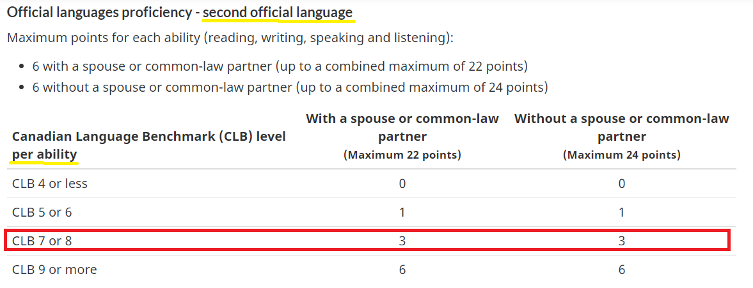
Additional Points for French Proficiency – Part 1

Slide 4
Scenario 2
My CRS Score is max 441.
Minimum ITA Cutoff for 2020 was 468*
Have Bachelors
CLB 10 in English
Age >= 29 and increasing ☹
Doing masters is not feasible for me.
So can I increase my score to obtain ITA ???
Answer is YES!

Slide 5
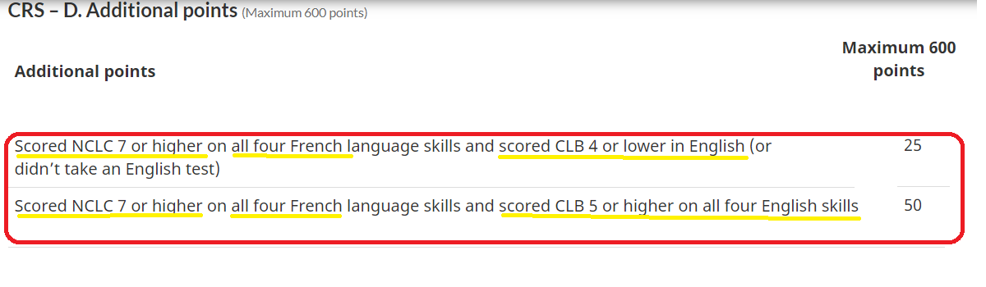
Additional Points for French Proficiency – Part 2

Slide 6
Pump up your CRS Score with Additional Points!
CLB 7 in French + CLB 5 in English → 50 Points!
CLB 7 in French + CLB 4 or lower in English → 25 Points!
+3 points for each ability → 12 Points!
Total Additional Points → 62 Points!
Ref: https://www.canada.ca/en/immigration-refugees-citizenship/services/immigrate-canada/express-entry/documents/language-requirements.html

Slide 7
Increase your chances for Ontario PNP
Eligible for Ontario’s Express Entry French-Speaking Skilled Worker stream
Minimum CLB 7 in French and CLB 6 for English
Ref: https://www.ontario.ca/page/ontarios-express-entry-french-speaking-skilled-worker-stream

Slide 8
Please Like, Share & Subscribe!

